Slide 1
AFT Workflow
Declaration of Variables
Enter CIF and Transfer Type
System Retrieves information about CIF
WF Retrieves Loan Payment Due
Yes
Frequency Options:
Daily, Monthly, Semimonthly, Loan Payment
Select Send Account, Receiver account, initial and final transfer date and frequency
If Frequency = Loan Payment
Enter Transfer Amount
No
WF Receives Document
Select Signer to Sign Form
Transfer Review
Esign Email To Client
WF does the Maintenance
Email Sent to User

Slide 2
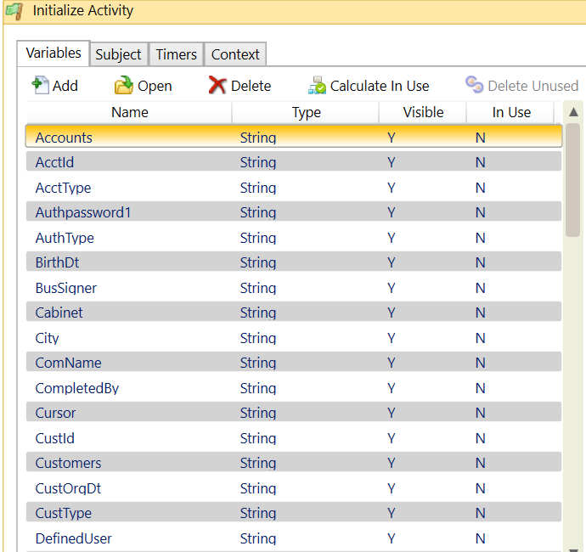
Variables

Slide 3
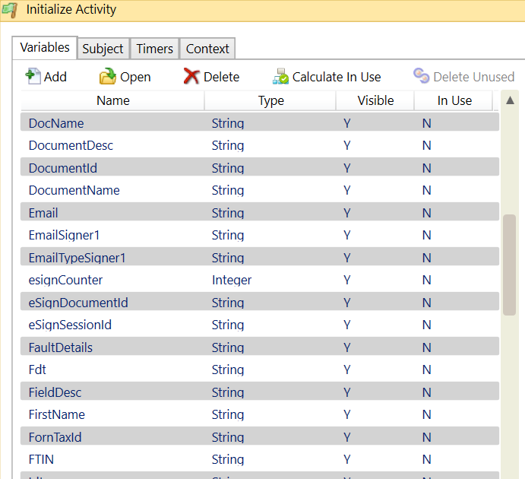
Variables

Slide 4
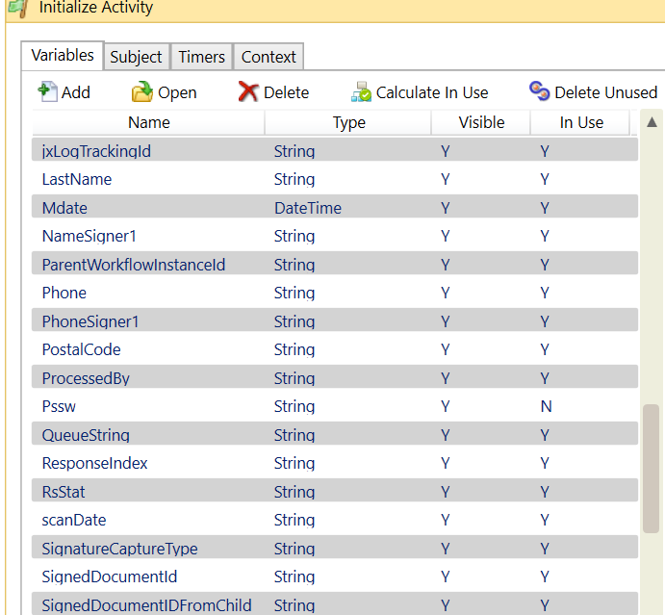
Variables

Slide 5
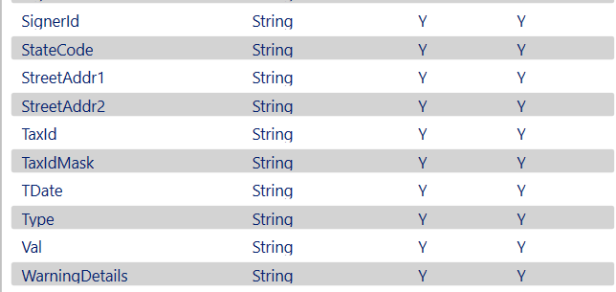
Variables

